Slide 1
Randomized Algorithm: Hiring Problem
Session 09
Henry Lucky, S.Kom. M.Kom.

Slide 2
Outline Materials
Session 04
The hiring problems
Indicator random variables
Randomized algorithm

Slide 3
Learning outcomes
09
LO 1: Explain fundamental concept of analysis algorithms
LO 2: Apply algorithm techniques and methods
LO 3: Solve a problem using specific algorithm.
LO 4: Compare several algorithm design methods

Slide 4
The hiring problems
Problem definition
Suppose that you need to hire a new office assistant.
The employment agency sends you one candidate each day. You interview that person and then decide either to hire that person or not.
You must pay the employment agency a small fee to interview an applicant.
However, to actually hire an applicant is more costly, since you must fire your current office assistant and also pay a substantial hiring fee to the employment agency. You are committed to having, at all times, the best possible person for the job.
You are willing to pay the resulting price of this strategy, but you wish to estimate what that price will be.

Slide 5
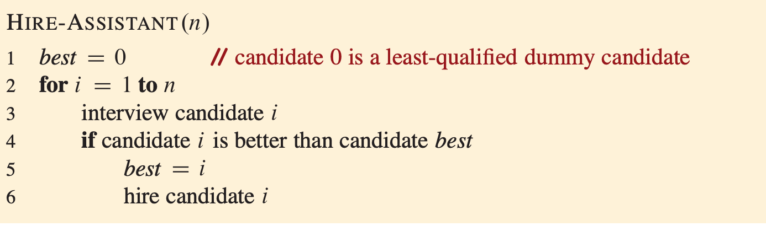
The hiring problems
Problem definition
The candidates for the office assistant job are numbered 1 through n and interviewed in that order.
The procedure assumes that after interviewing candidate i, you can determine whether candidate is the best candidate you have seen so far.
It starts by creating a dummy candidate, numbered 0, who is less qualified than each of the other candidates.

Slide 6
The hiring problems
Problem definition
The cost model for this problem differs from the model described in previous sessions.
We focus not on the running time of HIRE-ASSISTANT, but instead on the fees paid for interviewing and hiring.
On the surface, analyzing the cost of this algorithm may seem very different from analyzing the running time of, say, merge sort.
The analytical techniques used, however, are identical whether we are analyzing cost or running time.
In either case, we are counting the number of times certain basic operations are executed.

Slide 7

The hiring problems
Problem definition
Interviewing has a low cost, say $c_{i}$, whereas hiring is expensive, costing $c_{h}$.
Letting m be the number of people hired, the total cost associated with this algorithm is $O(c_{i}n+c_{h}m)$.
No matter how many people you hire, you always interview n candidates and thus always incur the cost $c_{i}n$associated with interviewing.
We therefore concentrate on analyzing $c_{h}m$, the hiring cost.
This quantity depends on the order in which you interview candidates.

Slide 8

The hiring problems
Worst-case analysis
In the worst case, you actually hire every candidate that you interview.
This situation occurs if the candidates come in strictly increasing order of quality, in which case you hire $n$times, for a total hiring cost of $O(c_{h}m)$.
Of course, the candidates do not always come in increasing order of quality.
In fact, you have no idea about the order in which they arrive, nor do you have any control over this order.
Therefore, it is natural to ask what we expect to happen in a typical or average case.

Slide 9
The hiring problems
Probabilistic analysis
Probabilistic analysis is used to analyze the running time of an algorithm. Sometimes, also to analyze other quantities, such as the hiring cost of HIRE-ASSISTANT procedure.
In order to perform a probabilistic analysis, we must use knowledge of, or make assumptions about, the distribution of the inputs. Then we analyze our algorithm, computing an average-case running time
For the hiring problem, we can assume that the applicants come in a random order. What does that mean for this problem? We assume that you can compare any two candidates and decide which one is better qualified, which is to say that there is a total order on the candidates.
Alternatively, we say that the ranks form a uniform random permutation, that is, each of the possible n! permutations appears with equal probability.
Notes:
More on total order: https://id.wikipedia.org/wiki/Urutan_total

Slide 10
The hiring problems
Randomized algorithms
In the hiring problem, it may seem as if the candidates are being presented to you in a random order, but you have no way of knowing whether they really are.
Thus, in order to develop a randomized algorithm for the hiring problem, you need greater control over the order in which you’ll interview the candidates.
So, on each day, you choose, randomly, which candidate to interview. This way, you enforced a random order.
More generally, we call an algorithm randomized if its behavior is determined not only by its input but also by values produced by a random-number generator.
When analyzing the running time of a randomized algorithm, we take the expectation of the running time over the distribution of values returned by the random number generator.
Notes:
More on total order: https://id.wikipedia.org/wiki/Urutan_total

Slide 11
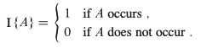
Indicator random variables
Indicator random variables provide a convenient method for converting between probabilities and expectations.
Given a sample space S and an event A, the indicator random variable I {A} associated with event {A} is defined as

Slide 12
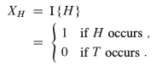
Indicator random variables
Example: coin flip
Let us determine the expected number of heads obtained when flipping a fair coin.
The sample space for a single coin flip is S={H,T}, with Pr{H}=Pr{T}= ½.
We can then define an indicator random variable Xh, associated with the coin coming up heads, which is the event H.
This variable counts the number of heads obtained in this flip, and it is 1 if the coin comes up heads and 0 otherwise. We write:

Slide 13
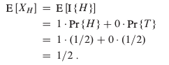
Indicator random variables
Example: coin flip
The expected number of heads obtained in one flip of the coin is simply the expected value of our indicator variable Xh:
Thus, the expected number of heads obtained by one flip of a fair coin is ½.
The expected value of an indicator random variable associated with an event A is equal to the probability that A occurs.

Slide 14
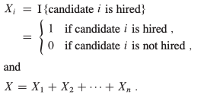
Indicator random variables
Analysis of hiring problems
In order to use a probabilistic analysis, let’s assume that the candidates arrive in a random order.
Let X be the random variable whose value equals the number of times you hire a new office assistant.
In particular, let Xi be the indicator random variable associated with the event in which the i-th candidate is hired. Thus,
E[Xi] = Pr{candidate I is hired}

Slide 15
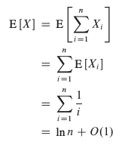
Indicator random variables
Analysis of hiring problems
Candidate i is hired, in line 6, exactly when candidate i is better than each of candidates 1 through i-1.
Because we have assumed that the candidates arrive in a random order, the first i candidates have appeared in a random order.
Any one of these first candidates is equally likely to be the best qualified so far.
Candidate i has a probability of 1/i of being better qualified than candidates 1 through i-1 and thus a probability of 1/i of being hired. E[Xi] = 1/i.

Slide 16

Indicator random variables
Analysis of hiring problems
Even though you interview n people, you actually hire only approximately ln n of them, on average.
Assuming that the candidates are presented in a random order, algorithm HIRE- ASSISTANT has an average-case total hiring cost of $O(c_{h}\ln{n})$, which is a significant improvement over the worst-case hiring cost of $O(c_{h}n)$.

Slide 17
Randomized algorithms
Assumptions vs expectations
In order to perform a probabilistic analysis, we must use knowledge of, or make assumptions about, the distribution of the inputs. (Average-case running time)
When analyzing the running time of a randomized algorithm, we take the expectation of the running time over the distribution of values returned by the random number generator. (Expected running time)
In randomized algorithms, instead of assuming a distribution of inputs, we impose a distribution.
Before running the algorithm, let’s randomly permute the candidates in order to enforce the property that every permutation is equally likely.
We expect this to be the case for any input, rather than for inputs drawn from a particular distribution.

Slide 18
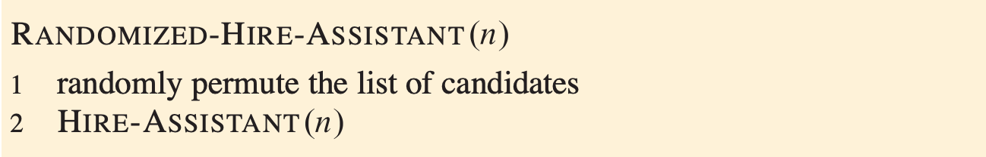

Randomized algorithms
Randomized version
For the hiring problem, the only change needed in the code is to randomly permute the array, as done in the RANDOMIZED-HIRE-ASSISTANT procedure.
This simple change creates a randomized algorithm whose performance matches that obtained by assuming that the candidates were presented in a random order.
Permuting the input array achieves a situation identical to that of the probabilistic analysis of HIRE-ASSISTANT
The expected hiring cost of the procedure above is $O(c_{h}\ln{n})$

Slide 19
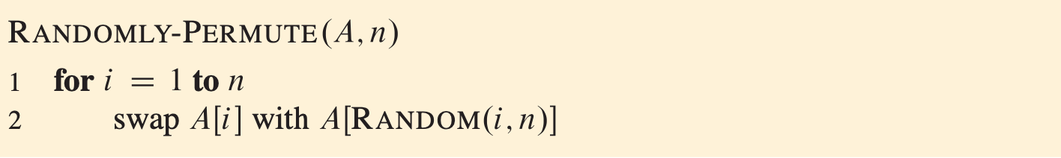
Randomized algorithms
Randomly permuting arrays
Many randomized algorithms randomize the input by permuting a given input array with the goal to produce uniform random permutation, that is, a permutation that is as likely as any other permutation.
Since there are n! possible permutations, we want the probability that any particular permutation is produced to be 1/n!
Above is a procedure taken from Fisher Yates algorithm. Now we are going to show that it produces a uniform random permutation with loop invariant.

Slide 20
Randomized algorithms
Randomly permuting arrays: Loop invariant
Given a set of n elements, a k-permutation is a sequence containing k of the n elements. There are n!/(n − k)! possible k-permutations of n elements
We use the following loop invariant:
Just prior to the i-th iteration of the for loop of lines 1– 2, for each possible (i−1)-permutation, the subarray A[1…i−1] contains this (i−1)-permutation with probability (n - (i - 1))!/n! = (n − i + 1)!/n!.

Slide 21
Randomized algorithms
Randomly permuting arrays: Loop invariant
Initialization:
Consider the situation just before the first loop iteration, so that i = 1. The loop invariant says that for each possible 1-1 = 0-permutation, the subarray A[1 . . 0] contains this 0-permutation with probability (n − i + 1)!/n! = n!/n! = 1.
The subarray A[1 . . 0] is an empty subarray, and a 0-permutation has no elements. Thus, A[1 . . 0] contains any 0-permutation with probability 1, and the loop invariant holds prior to the first iteration.
Just prior to the i-th iteration of the for loop of lines 1– 2, for each possible (i−1)-permutation, the subarray A[1…i−1] contains this (i−1)-permutation with probability (n - (i - 1))!/n! = (n − i + 1)!/n!.

Slide 22
Randomized algorithms
Randomly permuting arrays: Loop invariant
Maintenance:
We assume that just before the (i−1)st iteration, each possible (i − 1)-permutation appears in the subarray A[1 . . i − 1] with probability (n − i + 1)!/n!, and we will show that after the ith iteration, each possible i-permutation appears in the subarray A[1 . . i] with probability (n − i)!/n!.
Incrementing i for the next iteration will then maintain the loop invariant.

Slide 23
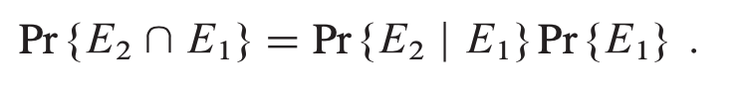
Randomized algorithms
Randomly permuting arrays: Loop invariant
Maintenance:
Let us examine the ith iteration. Consider a particular i-permutation, and denote the elements in it by < x1, x2, . . . , xi >. This permutation consists of an (i − 1)-permutation < x1, . . . , xi−1 > followed by the value xi that the algorithm places in A[i]. Let E1 denote the event in which the first i − 1 iterations have created the particular (i − 1)-permutation < x1, . . . , xi−1 > in A[1..i−1]. By the loop invariant, Pr(E1) = (n−i+1)!/n!. Let E2 be the event that ith iteration puts xi in position A[i]. The i-permutation < x1, . . . , xi > is formed in A[1..i] precisely when both E1 and E2 occur, and so we wish to compute Pr(E2 ∩ E1).

Slide 24
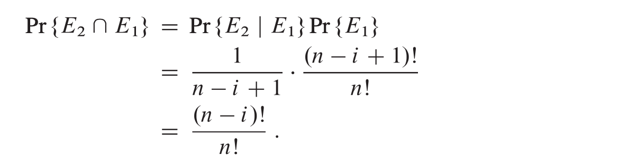
Randomized algorithms
Randomly permuting arrays: Loop invariant
Maintenance:
The probability Pr(E2 | E1) equals 1/(n−i+1) because in line 2 the algorithm chooses xi randomly from the n − i + 1 values in positions A[i . . n]. Thus, we have

Slide 25
Randomized algorithms
Randomly permuting arrays: Loop invariant
Termination:
At termination, i = n + 1, and we have that the subarray A[1 . . n] is a given n-permutation with probability (n − (n + 1) + 1)!/n! = (n − n)!/n! = 1/n!
Thus, RANDOMLY-PERMUTE produces a uniform random permutation.
A randomized algorithm is often the simplest and most efûcient way to solve a problem.

Slide 26
Exercises
09
In HIRE-ASSISTANT, assuming that the candidates are presented in a random or- der, what is the probability that you hire exactly one time? What is the probability that you hire exactly times?
Use indicator random variables to solve the following problem, which is known as the hat-check problem. Each of customers gives a hat to a hat-check person at a restaurant. The hat-check person gives the hats back to the customers in a random order. What is the expected number of customers who get back their own hat?

Slide 27
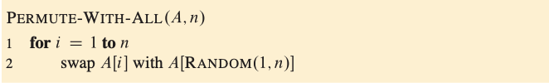
Exercises
09
Consider the PERMUTE-WITH-ALL procedure on the facing page, which instead of swapping element A[i] with a random element from the subarray A[i:n], swaps it with a random element from anywhere in the array. Does PERMUTE-WITH-ALL produce a uniform random permutation? Why or why not?

Slide 28
References
Thomas H. Cormen. (2022). Introduction to algorithms: Fourth edition. The MIT Press. Chapter 5.

Slide 29
Thank you
Randomized Algorithm: Hiring Problem
September, 2023

